Slide 1
Insurance Management System (Group 38)
Team Members:
Kishore Balaji(002333011) Abhinav Chinta(002331273) Pranit Mathyam(002059550)

Slide 2
Problem Statement:
In the insurance industry, managing policy creation, claims processing, customer data, and payment processing across multiple departments and enterprises can be challenging due to the lack of an integrated platform. This results in inefficiencies, delays, and data inconsistency, which negatively impact operational effectiveness and customer satisfaction.
This project aims to address these challenges by developing a unified Insurance Management System. The goal is to streamline insurance-related operations, ensure seamless collaboration between departments, and enhance customer service delivery through centralized data management

Slide 3




Tech Stack Used
Oracle Mail Authenticator
My SQL Database
Oracle Mail JAR
Java Swing UI

Slide 4
Solution:
We propose an Insurance Management Platform to manage policies, claims, payments, and customer interactions efficiently. The platform will provide role-based access, centralized data storage, and streamlined workflows across departments and enterprises.

Slide 5
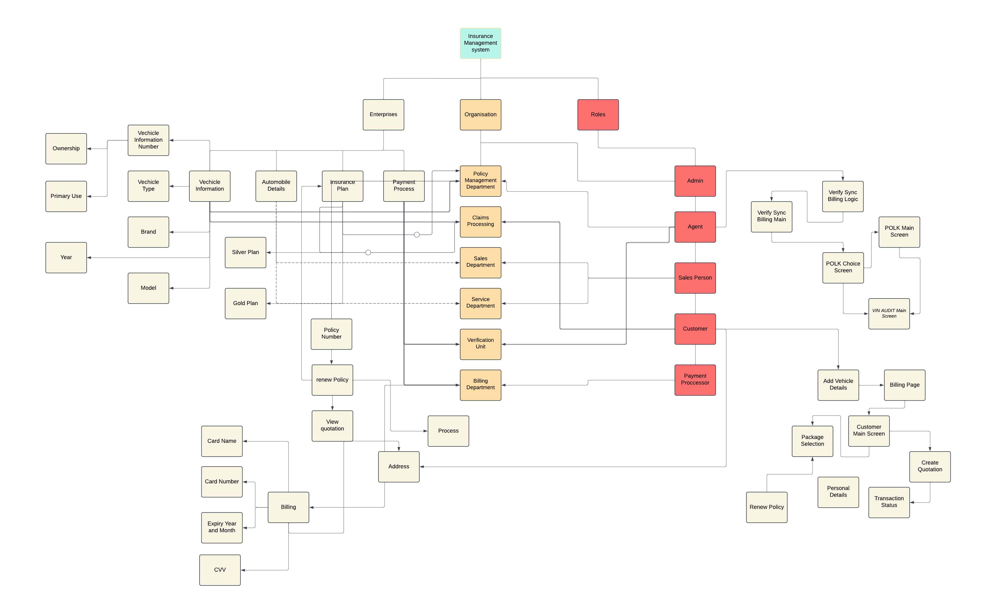
UML Diagram:

Slide 6
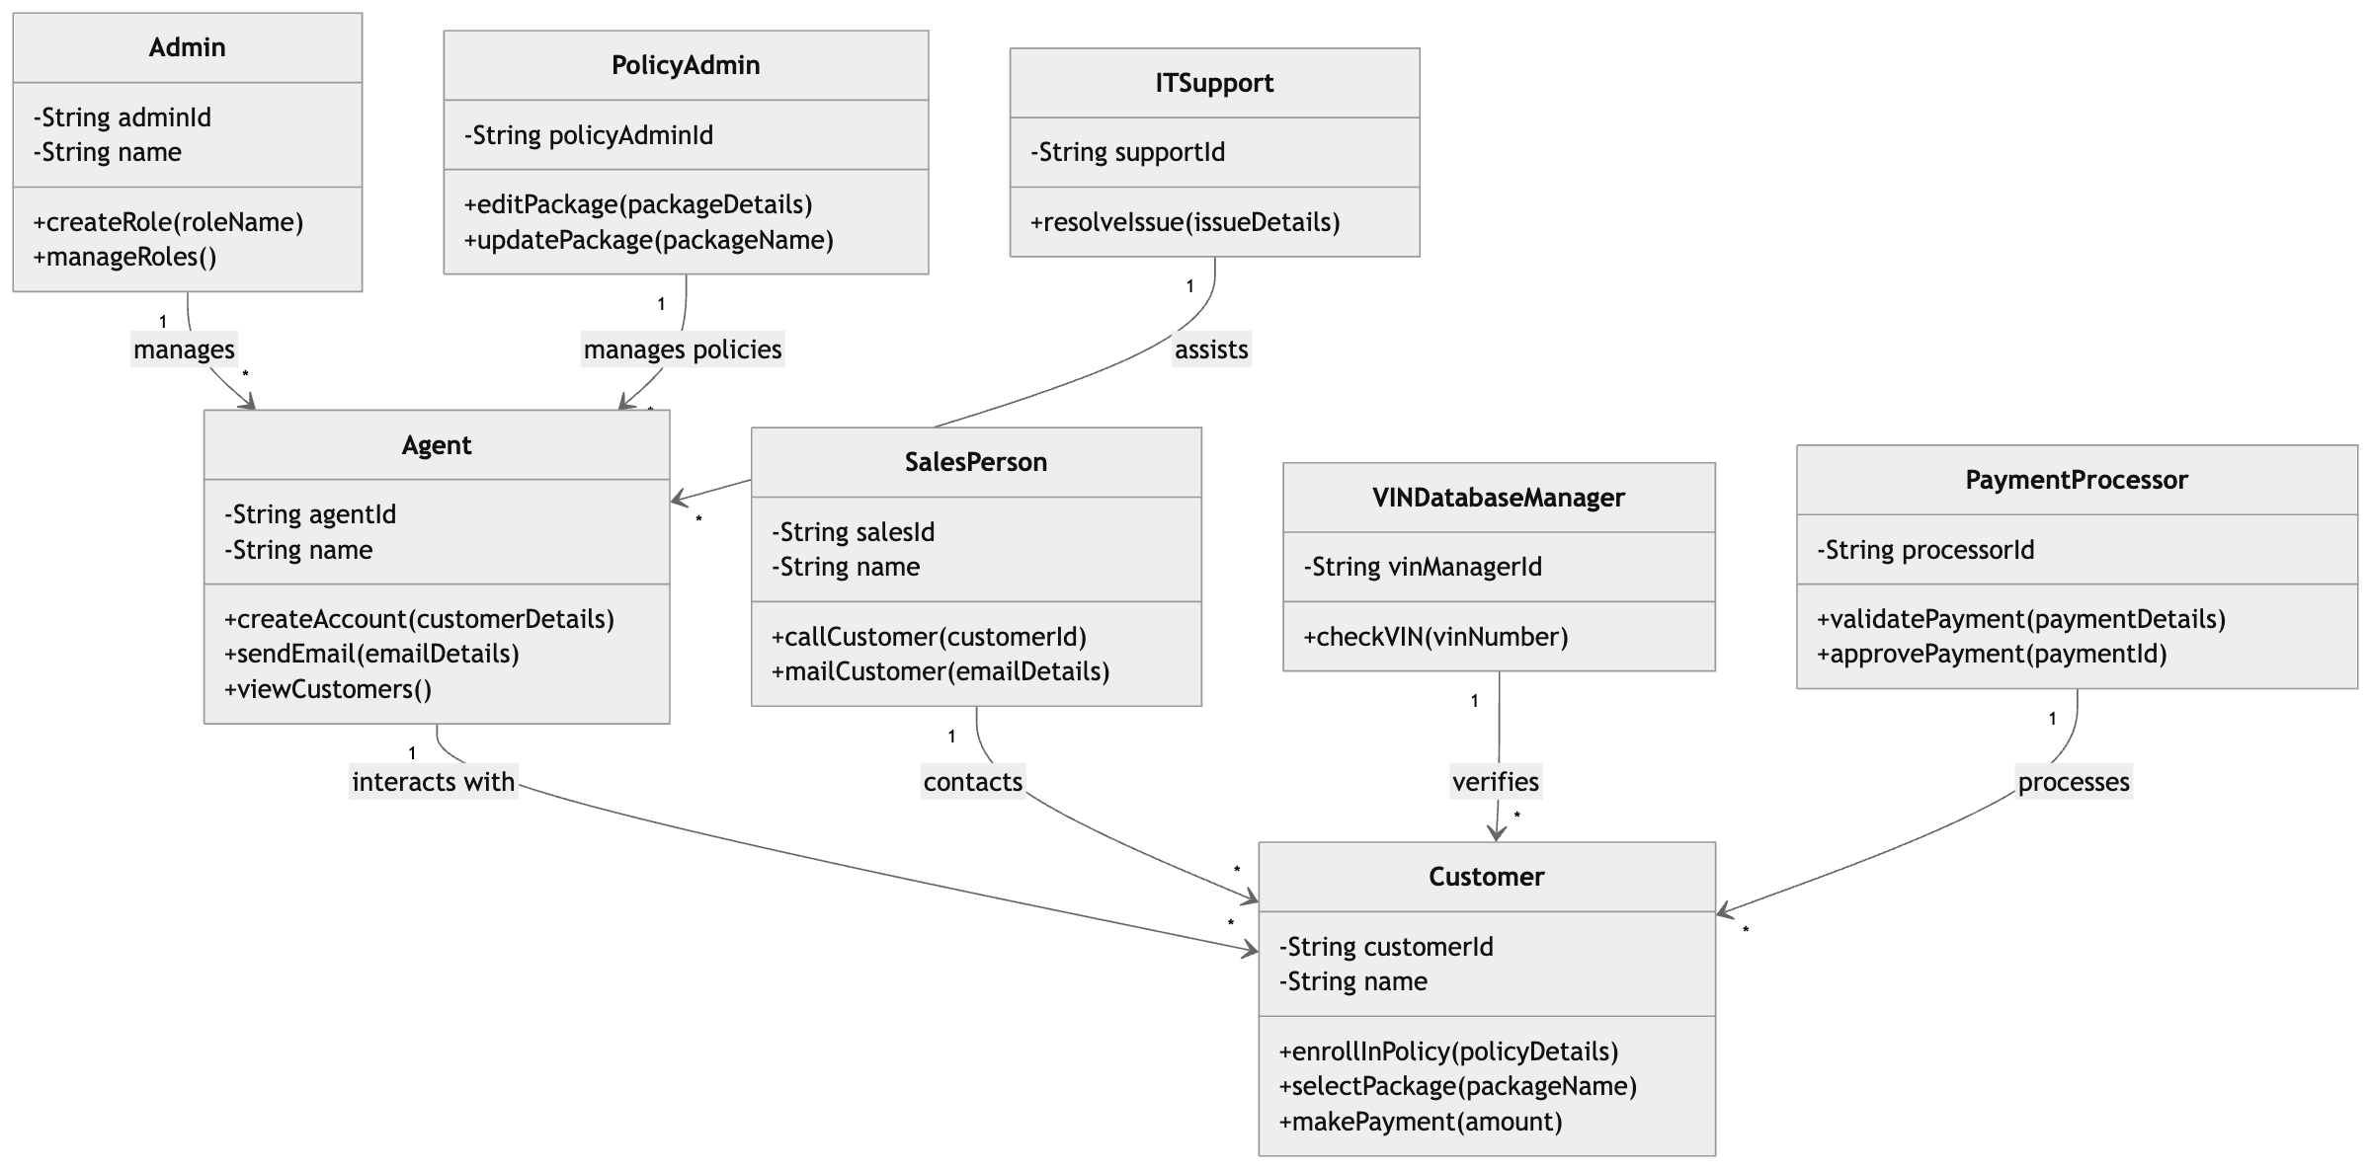
High-Level Component Diagram

Slide 7
Enterprises:
Policy Management Enterprise:
Focus: Handles policy creation, updates.
Roles: Policy Admin, VIN Database Manager .
Claims Processing Enterprise:
Focus: Manages claim submissions, verifications, and settlements.
Roles: Claims Admin.
Customer Support Enterprise:
Focus: Manages customer inquiries, feedback.
Roles: Sales Person, Agent, IT Support, Customer.
Payment Processing Enterprise:
Focus: Processes premium payments, refunds, and settlements.
Roles: Payment Processor.

Slide 8
Organizations
Policy Administration Department: Oversees all policy-related operations.
Claims Adjustment Unit: Handles claim verification and status management.
Support Team: Addresses customer issues and inquiries.
Billing and Payments Department: Manages premium payments and refunds.
Agent Operations Team: Supports insurance agents in policy sales and customer onboarding.
Sales and Business Development: Handles customer acquisition.

Slide 9
Roles:
Admin
Agent
Sales Person
Customer
Claims Processor
Policy Admin
Payment Processor
VIN Database Manager
IT Specialist

Slide 10
Thank You !

